Slide 1
RESUME, APPLICATION LETTER and OFFICE CORRESPONDENCES

Slide 2
My Dream Job:

Slide 3
A resume is a document used to present a person’s background and skills. It can be used for different reasons, but the most common purpose of a resume is for employment.

Slide 4
Resume contains:
Contact Information
Goals/Objectives
Qualifications
Educational Background
Work Experiences/Special Skills (Volunteer Work)
References

Slide 5
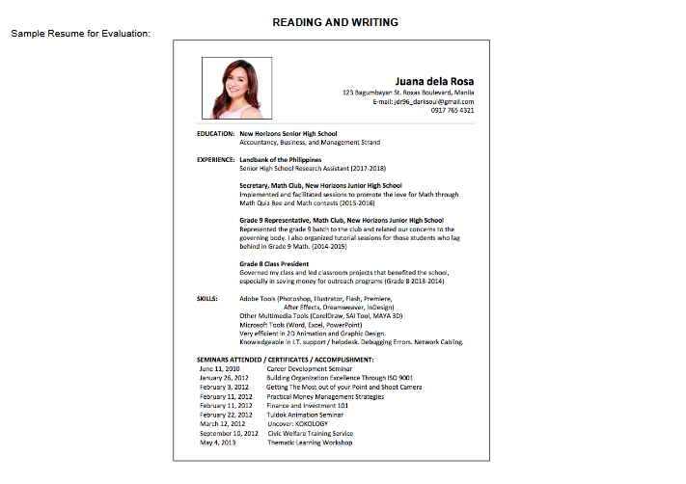

Slide 6
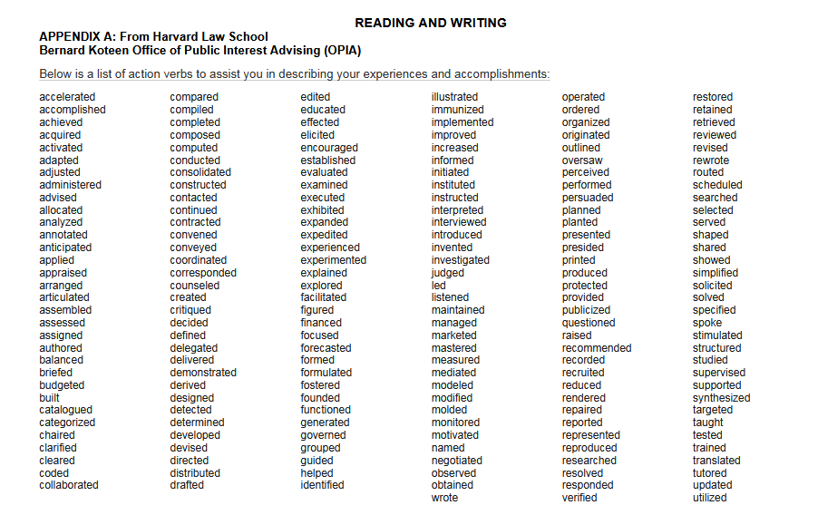

Slide 7
Application Letter
-also known as cover letter
-a document that provides additional information about a job application

Slide 8
Portfolio of Work
A portfolio is a collection of work samples that you can bring to an interview, send to a prospective employer, or even post online.
This can provide evidence of work that you’ve done.
Illustrate your skills and abilities.
Show your quality of your work.

